Slide 1
Qlik Replicate Change Data Capture (CDC) Enterprise Architecture Update DRAFT
Dec 2022
v0.1
Nishit Ajwaliya

Slide 2
Requirement
There is a need to make customer data available to the downstream systems from Customer core source systems CRIS and CSS in real-time or near real-time. There are two requirements that we need to satisfy. First, capture change data from source systems in real or near-real time. Second, make them available for the downstream systems.
# | Requirement Category | Requirement Detail | Consumers
1 | Source systems data accessibility | Able to access any customer data changes from both source systems in real-time to near real-time Able to prioritize as per the data needs and classification | Customer Data Platform
2. | Availability | Customer data available to downstream systems 24x7, near real-time or batch Able to provide access to incremental changes | UWP 1.0/2,0, Clean Energy 2.0, AMI, C2C, ZBR, Various Digital programs and Web applications etc.
3. | Volume | All customers from both source systems All business data for each customer from both source systems | Customer Data Platform
4. | Reduce resource usage on Mainframe servers | Offload the Mainframe server load to reduce the MIPS usage Add required resources to mainframe server requires for the new solution | CSS, CRIS
5. | Future proof | Able to support future CSS records volume increase | CRIS to CSS migration (C2C)

Slide 3
Challenges/Limitations
# | Challenges | CSS | CRIS
1 | Real time refresh | Data refreshed using batch process once a day | Real-time data is pushed using .NET MQ by MuleSoft except during CRIS batch process – outage time
2 | Data completeness | Around 40 tables are replicated out of required ~100 in CSS, also data filtered during batch process | Supports customers that have online profile/accounts (~50%) and expectation is that we need access to all customer records
3 | Missing Audit columns | Underlying data sources not having audit columns which makes data pull a challenge | Underlying data sources not having audit columns which makes data pull a challenge
4 | Performance Issues | Multiple systems are trying to get data from source systems and causing availability of mainframe resources | CRIS system batch processes transactions nightly and this leads to sync and performance issues with Queue replication and MuleSoft data transfer

Slide 4
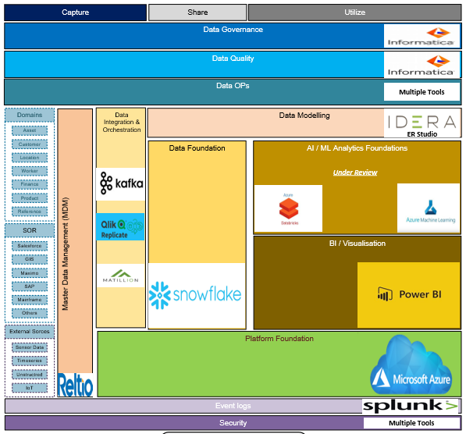
NG Reference Data Architecture

Slide 5
Qlik Replicate Architecture

Slide 6
Physical Architecture (Non-Prod) – As of Oct 2022

Slide 7
Physical Architecture (PROD) – As of Oct 2022

Slide 8
Current Status
Near real-time change data sync from CSS to Snowflake of 88 tables from Oct 23, 2022
Near real-time change data sync from CRIS to Snowflake of 86 tables from Oct 23, 2022
Next
More CSS tables to be added to change data sync
More CRIS tables to be added to change data sync
UWP 2.0 data sync from CSS (couple of tables) to Azure EventHub/Kafka (Target Feb 2023)
Important links:
Qlik Replicate PoaP
EDP Data Usage Patterns and Decision Tree

